Slide 1
Insights about Inflation vs S&P 500 Index
How do the returns look like in investing in S&P 500 Index fund?
Presented by: Emma Li
Last Updated: May 20, 2022

Slide 2
Goals for Our Discussion Today
1
Examine correlation between inflation and S&P 500 Index
We’ll cover how the two are not obviously correlated by examining a scatter plot.
2
Compare 10-year rolling returns on S&P 500 Index investment
Seeing 10 year returns will give us an idea whether such investment is a safe option.
3
Discuss potential directions for further exploration
Investing in funds mimicking S&P500 doesn’t always have a positive return. More research can be done on identifying the worst time to invest.

Slide 3
Datasets Used
S&P 500 Index historical data
https://www.investing.com/indices/us-spx-500-historical-data
Consumer Price Index less food and energy data
https://data.bls.gov/cgi-bin/surveymost?cu
Retrieved on May 9, 2022
Monthly data between 1990 and 2022

Slide 4
S&P 500 Index
An index that tracks 500 of the largest U.S. companies based on their market capitalization
You can invest in funds such as VOO that mirror S&P 500.
Notes:
VOO: Vanguard S&P 500 ETF

Slide 5
Consumer Price Index (CPI)
CPI is a measure of the average change over time in the prices paid by urban consumers for a market basket of consumer goods and services.
This dataset can be used to calculate annual core inflation rate.
Notes:
The core rate excludes food and energy prices because they vary too much from month to month. This exclusion makes the core rate more accurate than the headline inflation rate in measuring underlying inflation trends.

Slide 6
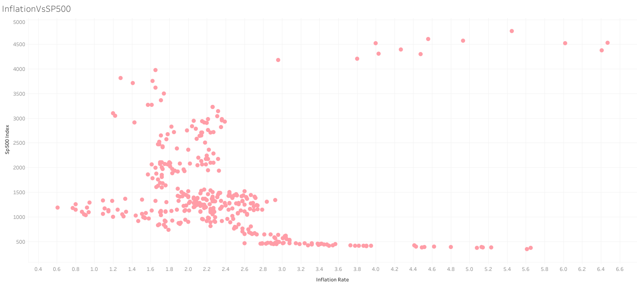
No correlation between inflation and S&P 500 Index
No obvious correlation between inflation and S&P 500 index is shown on the plot.
The lack of correlation is further proved by the value of correlation coefficient -0.04.
Annual inflation rate is calculated by using CPI index data.
Annual inflation rate data is from Jan 1991 to May 2022.
Notes:
Annual inflation rate data is from Jan 1991 to May 2022. Inflation rates in 1990 are missing because they can’t be calculated without the CPI data in 1989.

Slide 7
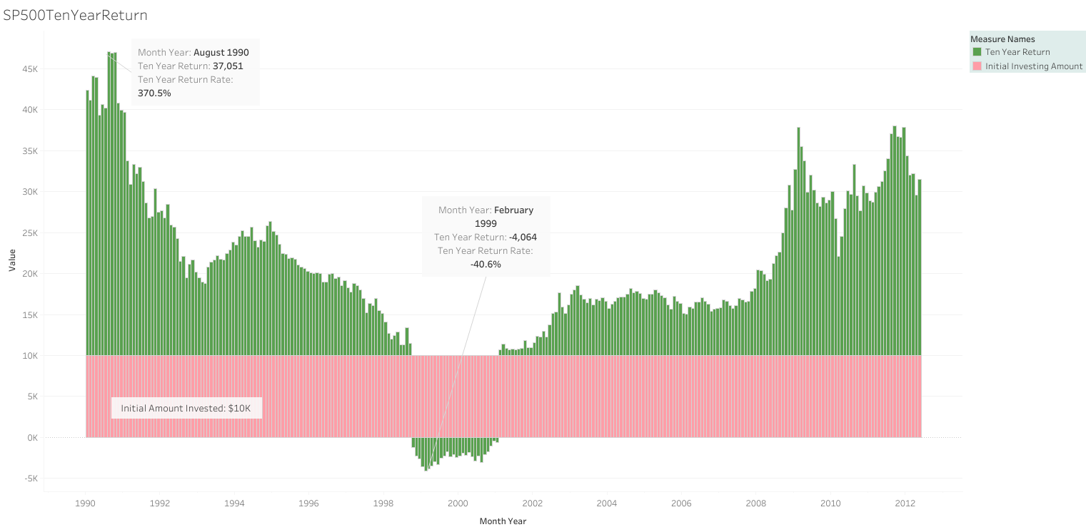
10-year Returns Investing in S&P 500
With $10K investment, the highest 10-year return is $37,051, whereas the lowest is -$4,064.
The possibility of increasing your money within 10 years is 89.59%.
Notes:
Our data shows 10 year hypothetical returns if one invests in S&P 500 starting from each month from Jan 1990 to May 2012.
The return doesn’t consider investment management fee or dividend.

Slide 8
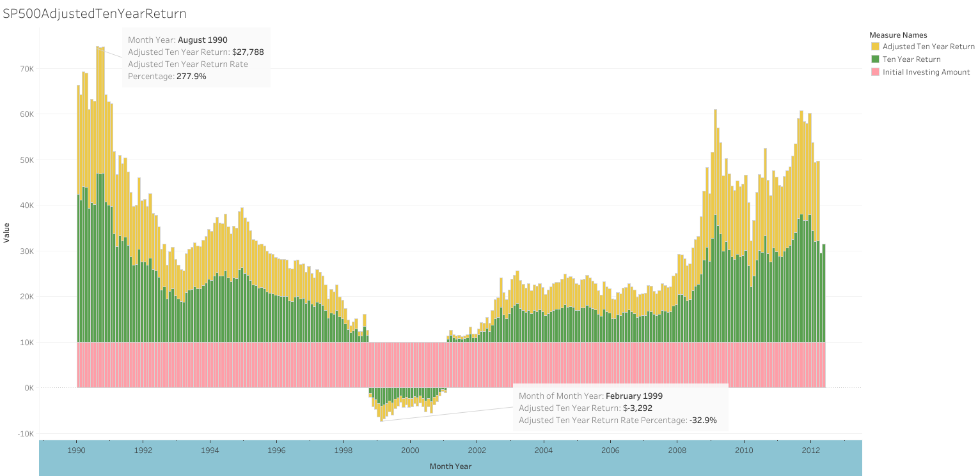
Inflation-Adjusted 10-year Returns Investing in S&P 500
The highest adjusted 10-year return is $27,788, whereas the lowest is -$3,292.
The possibility of increasing your money within 10 years is still 89.59%.

Slide 9
Possible directions for further exploration
We see from the 10-year return graph that investment in funds mimicking S&P 500 does not always guarantee a positive return.
Strategies on how or when to invest in funds that mimic S&P 500 could be especially useful for novice investors like myself.
Questions like “What would a longer term of investing such as 15 years or 20 years look like?” or “Does Dollar-Cost Averaging help reduce the risk of loss?” are worth exploring further.

Slide 10
Conclusion
Inflation rate cannot be used as a reference for one to decide when to invest in funds that mimic S&P 500 index, as no obvious correlation between them is found.
The likelihood of one growing their money by investing in funds that mimic S&P 500 index is quite high (89.59%). It could be considered as a very safe investment option.

Slide 11
References:
https://www.investopedia.com/ask/answers/how-can-i-buy-sp-500-fund/
https://www.investopedia.com/terms/c/consumerpriceindex.asp
https://www.thebalance.com/core-inflation-rate-3305918

